Slide 1
Building a neural network

Slide 2

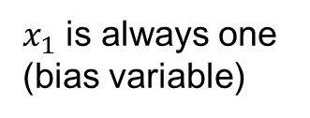


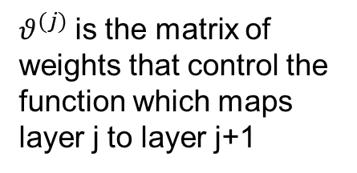







Neurons
$x_{1}$ is always one (bias variable)
Layer number
$$x_{1}$$
$$a_{1}^{(2)}$$
$$a_{i}^{(j)}$$
Unit number
$$x_{2}$$
$$a_{2}^{(2)}$$
$$h_{θ}x$$
$$x_{3}$$
$$a_{3}^{(2)}$$
$θ^{(j)}$is the matrix of weights that control the function which maps layer j to layer j+1
$$x_{n}$$
$$a_{4}^{(2)}$$

Slide 3
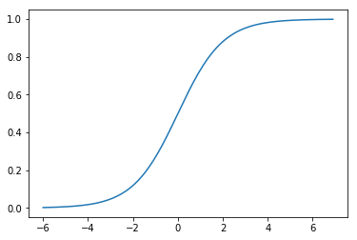
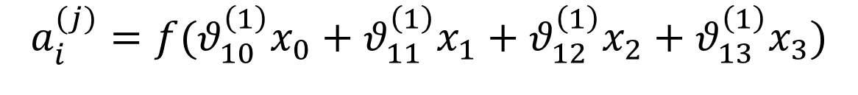




How is $a_{i}^{(j)}$ Calculated?
Input array
$$x^{T}= (x_{0} x_{1} x_{2} x_{3})$$
Weights array
$$θ^{(1)}=[θ_{10}^{\left(1\right)} θ_{11}^{\left(1\right)} θ_{12}^{\left(1\right) } θ_{13}^{\left(1\right)}]$$
$$a_{i}^{(j)}=f(θ_{10}^{\left(1\right)}x_{0}+θ_{11}^{\left(1\right)}x_{1}+θ_{12}^{\left(1\right)}x_{2}+θ_{13}^{\left(1\right)}x_{3})$$
Layer number
$$a_{i}^{(j)}$$
Activation function
Linear combination of inputs
Unit number
(Sigmoid)

Slide 4







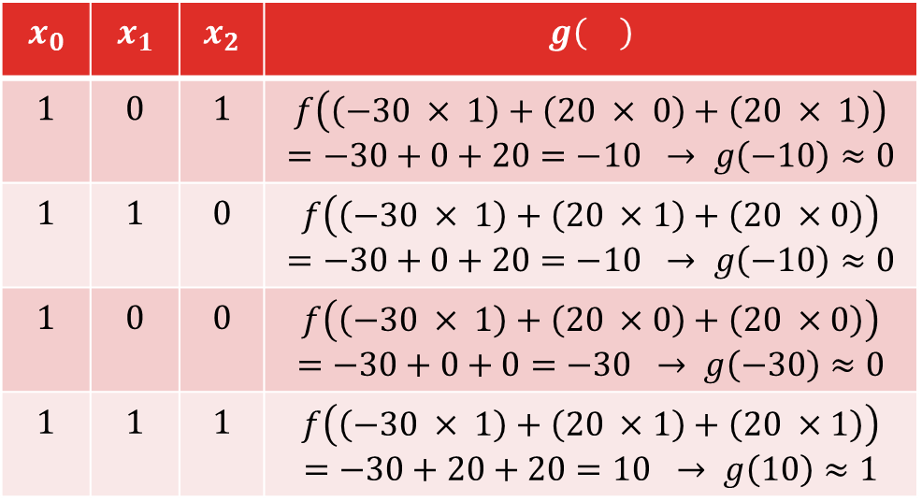
How is the output calculated?
$$h_{θ}(x)=f(θ_{10}^{\left(1\right)}x_{0}+θ_{11}^{\left(1\right)}x_{1}+θ_{12}^{\left(1\right)}x_{2})$$
$$h_{θ}x$$
$$x_{0}$$ | $$x_{1}$$ | $$x_{2}$$ | $$g\left(\right)$$
$$1$$ | $$0$$ | $$1$$ | $$f\left(\left(−30 × 1\right)+\left(20 × 0\right)+\left(20 × 1\right)\right)$$ $$=−30+0+20=−10 → g\left(−10\right)≈0$$
$$1$$ | $$1$$ | $$0$$ | $$f\left(\left(−30 × 1\right)+\left(20 ×1\right)+\left(20 ×0\right)\right)$$ $$=−30+0+20=−10 → g\left(−10\right)≈0$$
$$1$$ | $$0$$ | $$0$$ | $$f\left(\left(−30 × 1\right)+\left(20 ×0\right)+\left(20 ×0\right)\right)$$ $$=−30+0+0=−30 → g\left(−30\right)≈0$$
$$1$$ | $$1$$ | $$1$$ | $$f\left(\left(−30 × 1\right)+\left(20 ×1\right)+\left(20 ×1\right)\right)$$ $$=−30+20+20=10 → g\left(10\right)≈1$$
$$θ_{10}^{\left(1\right)}$$
$$θ^{(1)}=[−30, 20, 20]$$
$$θ_{11}^{\left(1\right)}$$
$$h_{θ}x$$
$$θ_{12}^{\left(1\right)}$$
If $x_{1} { AND x}_{2}$ are 1, the output will be one. The neuron ‘fires’ (sends signal to next layer).

Slide 5
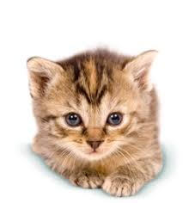
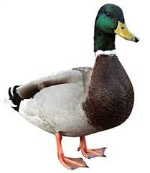



What is the output?
For the binary example we have been looking at the output will be a $2×1$ array.
$$h_{θ}\left(x\right)=\left[\begin{aligned}1 \\ 0\end{aligned}\right]$$
Say the problem that we are solving is to classify images of cats and ducks. The outputs we want will be:
$$h_{θ}\left(x\right)=\left[\begin{aligned}1 \\ 0\end{aligned}\right]$$
$$h_{θ}\left(x\right)=\left[\begin{aligned}0 \\ 1\end{aligned}\right]$$
https://www.pets4homes.co.uk/sale/cats/
https://www.collinsdictionary.com/dictionary/english-portuguese/duck

Slide 6











$$w_{i1}$$
$$x_{1}$$
$$w_{i2}$$
Activation Function
$$x_{2}$$
$$\sum_{j=1}^{n}{x_{j}w_{ij}}$$
Output
Sum
$$y_{i}$$
$$x_{3}$$
$$w_{i3}$$
$$x_{n}$$
$$w_{in}$$
https://www.warrenphotographic.co.uk/28737-ginger-and-white-kitten

